Slide 1
Exploring Transparency Mechanisms for Identification of Interaction Failures in HRI
Preeti Ramaraj
Soar Workshop ‘19
05/09/19

Slide 2
Outline
Motivation
Related work
Transparency mechanisms
Taxonomy of interaction failures
User study
Results
Discussion
Notes:
This is going to be my outline. I am going to present my moti and related work -> details of the talk.

Slide 3
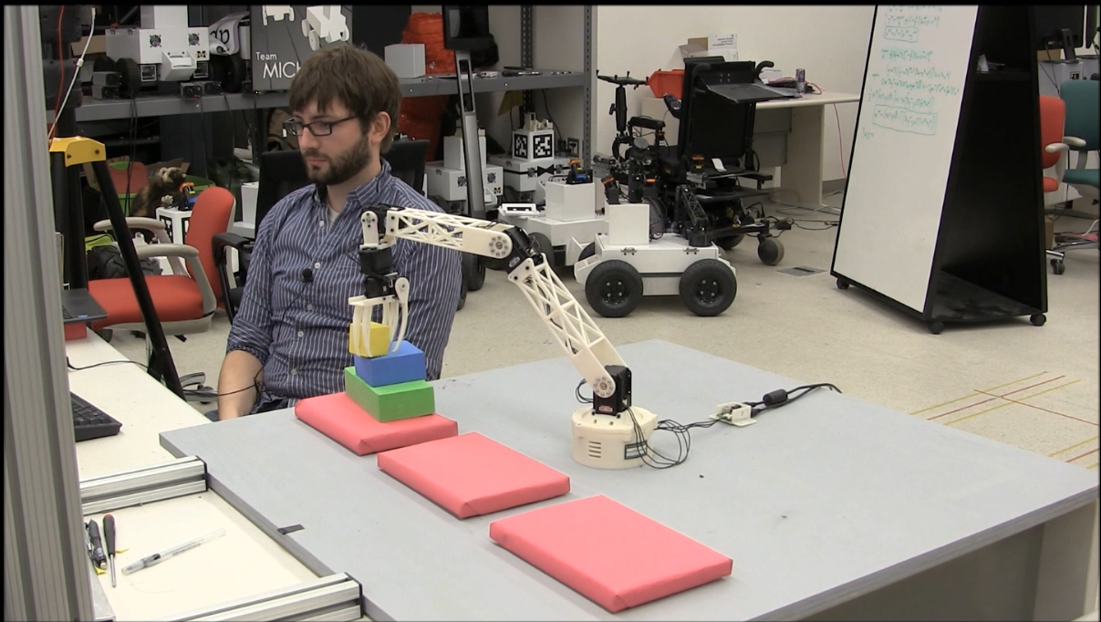
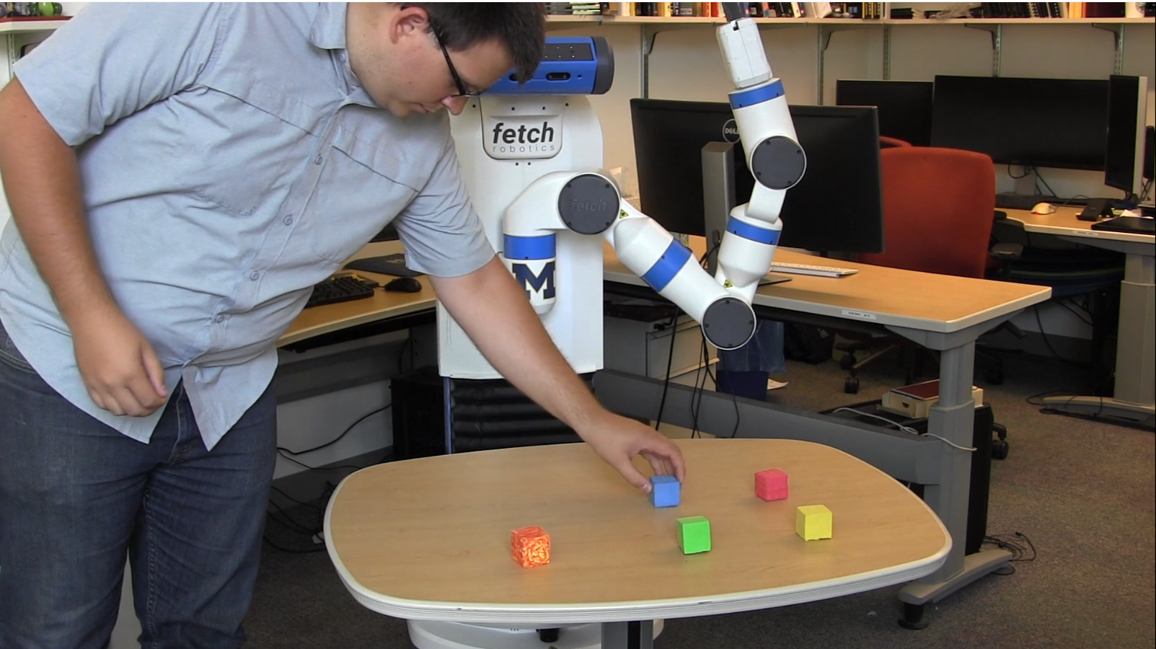
Interactive task learning robot
Learns new tasks through instruction from humans
Using language and demonstration
Goal: Non-expert users can interact with and teach ITL robots
Notes:
We have heard about ITL robots and rosie, and the robot is able to learn all these complex tasks. and it is evident that the goal is blah. However untl now, only explored with expert users who have complete knowledge of rosie and its idiosyncrasies. One of the reasons we are far away from this goal is that
Inspired from human-human teaching. This means that youo don’t need to code in order to teach this robot new tasks which is great and keeping that in mind, the goal of ITL is for non-expert users to be able to interact with and teach these robots successfully.
But until now most work has explored either expert users, people who can successfully interact with these robots or simple commands that do not deal with full fledged tasks. Current robots are too complex and they’ve only looked at
However, in its current state, that is not easily possible. There are two reasons for the same.

Slide 4


Non-expert user has an incomplete mental model of the ITL robot
Non-Expert
ITL robot

Slide 5

Problem: User’s incomplete mental model of the robot
Mental model
Capabilities
Shortcomings
Goals
Knowledge
?
Non-Expert
ITL robot
Notes:
This mental consists of assumptions of capabilities, shortcomings, goals and knowledge of the robot that this user would make. Now why is this a problem?

Slide 6

Problem: User’s incomplete mental model of the robot
Incomplete mental models lead to interaction failures
The goal of tower-of-hanoi is set up.
I don’t see the goal.
Non-Expert
ITL robot
Notes:
The user expects the robot to say “Ok”
Instead it says nothing. And fails
The user’s instruction has not been understood, leading to an interaction failure.
Incomplete not unique to human-robot.
Let us assume the user wants to tell the robot the goal is setup, but the robot cannot see the blue block on top. The robot fails and might tell you it failed but the user has no idea why. tTypically in human-human conversation, the partner would have let the person know that they can’t quite see the block for whatever reason. And that is where we hit problem 2.
But what about improving the user’s mental model of the robot when their conversation results in an interaction failure?

Slide 7
Potential approach: User learns about ITL robot
Perception failure?
Goal?
Tower of Hanoi?
I don’t see the goal.
The goal of Tower-of-Hanoi is set up.
Non-Expert
ITL robot
Notes:
Expectation is that the robot will say something to help resolve this mismatch. But current robots do noth ave enough interaction skills, including context information, what the user knows about itself and the situation, in order to convey why it did not understand what the user asked it to do , and engage in such a back and forth conversation.
User is left with an incomplete model, not knowing what happened in the robot. Is there an alternative way to this?
In order to confirm whether it knows the goal right? So the robot can’t automatically engage in conversation like people do, to engage in this conversation. So what’s a solution
Is there an alternate way in which we can update the non-expert’s mental model of the robot?

Slide 8

Approach: Transparency mechanisms
Transparency mechanisms provide the user with information about a robot’s internal processes
I see a green block on a red block and the red block on an orange location. I also see a green location and a yellow location.
What do you see?
Non-Expert
ITL robot
Notes:
Ask what the robot can see? Get answer -> gap in mental model filled. So leads me to my first research question
So today my talk is going to be about how we implemented specific transparency mechanisms in order for a non-expert user to be able to identify why the robot failed. Clearly, this is the first crucial step.
How do we quantify this? By using the user’s accuracy and confidence to do the same.again, very little work has looked at just quantifying a person’s mental model when it comes to a robot. We think we ought to take a smaller step approach to this.

Slide 9
Research questions
How can transparency mechanisms help a user identify the reason for an interaction failure?
Non-Expert
ITL robot
Notes:
We saw one kind of failure which was because of faulty perception. Let’s lookat another example.

Slide 10
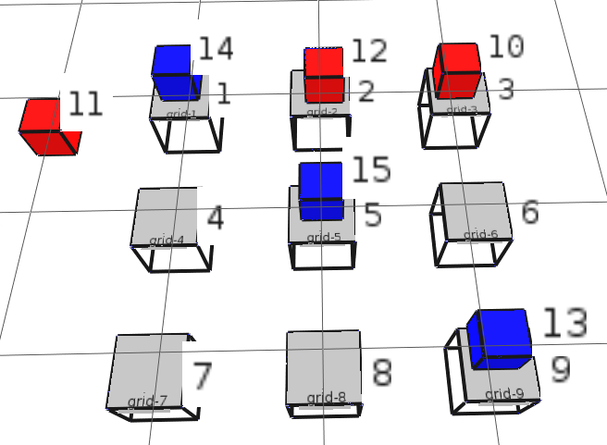
Problem 2: Different kinds of failure
red = my-piece
The goal is that three locations in a line are captured.
A goal of tic-tac-toe is set up.
I don’t see the goal.
Non-Expert
ITL robot
Notes:
Tic=tac=toe, robot has internal thoughts, the user sets up goal, the robot says it can’t see it.
User can’t figure what’s wrong just with perception, they need access to robot’s predefined knowledge about the game.

Slide 11
Research questions
How can transparency mechanisms help a user identify the reason for an interaction failure?
How do transparency mechanisms expose different kinds of failure to the user?
Non-Expert
ITL robot
Notes:
How much information (via transparency mechanisms) is required to fill the gap of mental model?

Slide 12
Related work – Transparency mechanisms
Language
Gestures
Gaze
Visualization Mechanisms
Notes:
Transparency mechanisms have been explored before in these forms.
Language – Robot asks questions to clarify request, provides uncertainty information, asks for help with specific objects
Gestures – these including nodding and shrugging motions, pointing to relevant objects, facial expressions
Gaze – not only contributes to interactions, helps establish what you’re referring to in the environment
However, the focus has been on improving the robot’s understanding of human’s instruction and not the human’s perspective.
getting the robot to do better in a specific task or a subset of tasks. Our robot can learn multiple tasks, so we explore these transparency mechanisms in a more general sense. Secondly, only two
The goal here has been improiging the robot’s performance .

Slide 13
Related work – Classifying interaction failures
Hirst et al. (1994)
Misunderstanding and non-understanding
Marge and Rudnicky (2017)
Ambiguity
Notes:
On the other hand, interaction or communication failures in human-human interaction have been studied
Hirst et al identified miscommunications that occur in human-human dialogue and ways to
Marge and rudnicky crowd-sourced responses in situations where there was a situated grounding failure or success between a human and a robot. They collected responses from participants on possible robot responses.
These interaction failures have always been studied from the point of view of how to help the robot do the task better.
Misunderstanding is when an utterance is misinterpreted but the speaker may still belive that the communication was ithout error. Ambiguity is when the speaker does not provide insufficient information to decide which is the referent they are referring to.
Both these works individual look at datasets of people where these types of failures occur and how they resolve it. Marge and Rudnicky additionally solicit ideal robot responses from people in a given task.
In our case, we are looking into how people interpret robot’s failures and better understand it using transparency mechanisms
Humans resolve these failures using a combination of gestures nad language. Games and puzzles provide a good test-bed since in Rosie, learns in a shared environment using situated language, that provides a mix of perception and concept-based failures

Slide 14
My work
How do humans interpret human-robot interaction failures?
Notes:
On the other hand, human-
Hirst et al identified miscommunications that occur in human-human dialogue and ways to
Marge and rudnicky crowd-sourced responses in situations where there was a situated grounding failure or success between a human and a robot. They collected responses from participants on possible robot responses.
These interaction failures have always been studied from the point of view of how to help the robot do the task better.
Misunderstanding is when an utterance is misinterpreted but the speaker may still belive that the communication was ithout error. Ambiguity is when the speaker does not provide insufficient information to decide which is the referent they are referring to.
Both these works individual look at datasets of people where these types of failures occur and how they resolve it. Marge and Rudnicky additionally solicit ideal robot responses from people in a given task.
In our case, we are looking into how people interpret robot’s failures and better understand it using transparency mechanisms
Humans resolve these failures using a combination of gestures nad language. Games and puzzles provide a good test-bed since in Rosie, learns in a shared environment using situated language, that provides a mix of perception and concept-based failures

Slide 15
Outline
Transparency mechanisms
Taxonomy of interaction failures
User study
Results
Discussion
Notes:
How do our implemented transparency mechanisms help the user identify the reason for these failures.

Slide 16
Outline
Transparency mechanisms
Taxonomy of interaction failures
User study
Results
Discussion
Notes:
How do our implemented transparency mechanisms help the user identify the reason for these failures.

Slide 17
Implemented transparency mechanisms
Q-A mechanisms
Screen-based mechanisms
Notes:
Q-a mechanisms = user can ask questions to the robot
Screen-mechanisms = user can see visually the robot’s point of view.
I am presenting a subset of these for examples, the complete list is in the appendix

Slide 18

TM1: Q-A mechanisms
Perception
What do you see?
Describe the green block.
What is below/on the blue location?
Long Term Knowledge
What is the goal of Tower-of-Hanoi?
What is ‘clear’?
What is the action of Tower-of-Hanoi?
Notes:
Through my implementation, NOW the user can ask the robot questions about its perception

Slide 19
TM1: Q-A mechanisms
Instantiation of knowledge in its environment
User: Do you see the goal of Tower-of-Hanoi?
Rosie: Yes
Rosie: No. A blue block is not on a green block.
Perception
4
Perception
5
5
6
4
6
Location 1
Location 2
Location 3
Location 1
Location 2
Location 3
Notes:
These

Slide 20
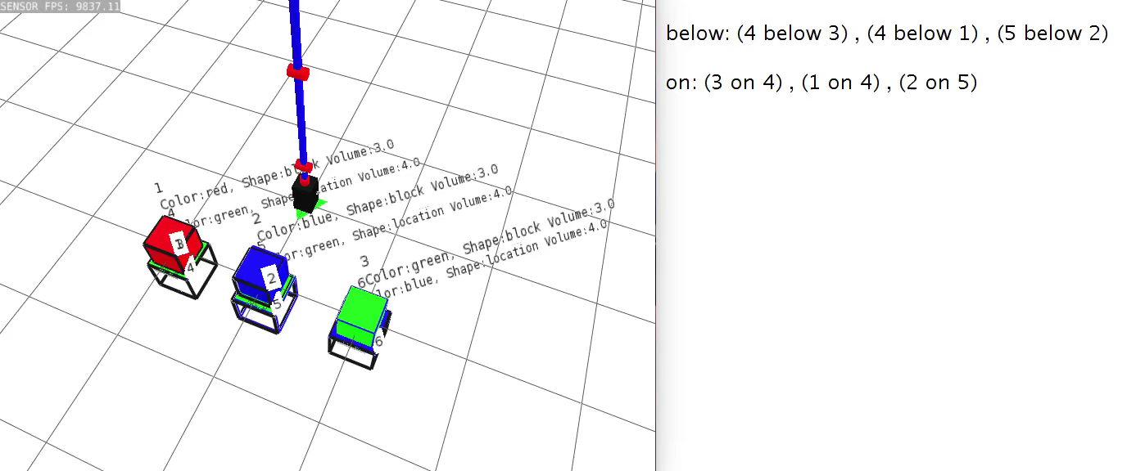
TM2: Screen-based mechanisms
Constant access to its primitive relations
Notes:
This is the simulated environment where these mechanisms were implemented. The long-blue thing is the table-top robot, this is the environment with three blocks and three locations.
Screen-based mechanisms -> visual modality.
I implemented a side panel where the user can have continuous access to the robot’s observed primitive relations.

Slide 21
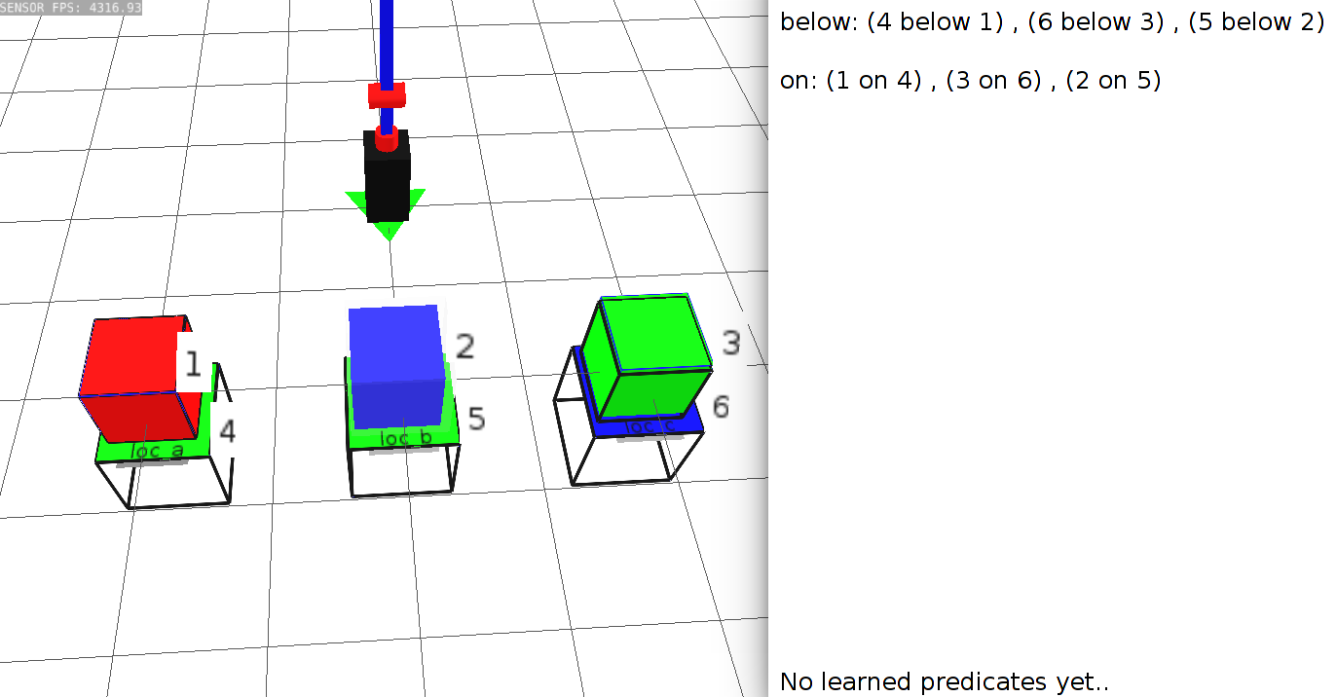
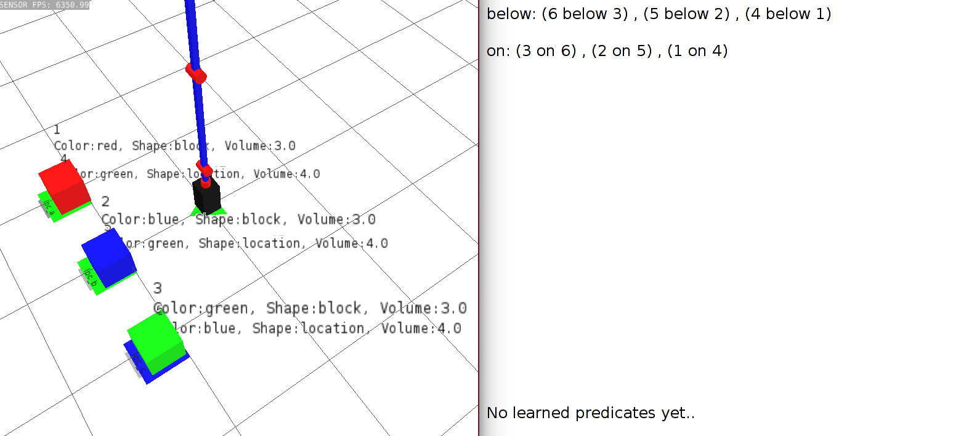
TM2: Screen-based mechanisms
Request properties of objects
User: Show me the object properties
Notes:
The user can just see ethe properties of the object Secondly, the user can ask to display properties of object

Slide 22
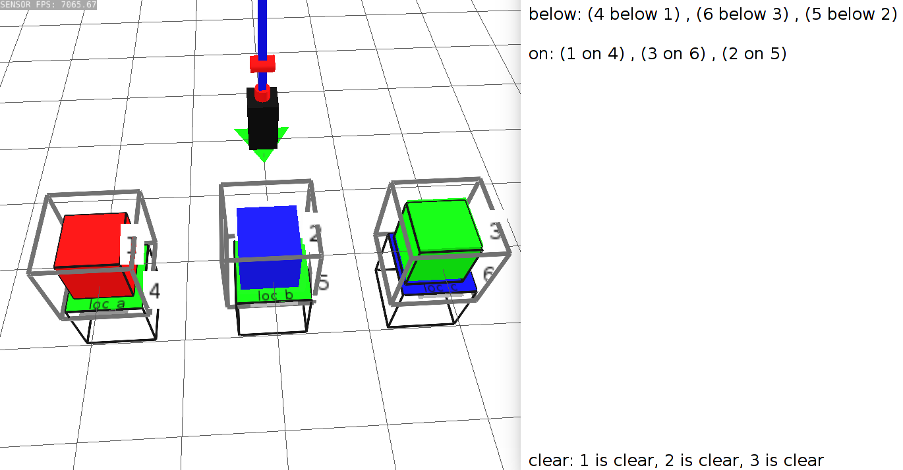
TM2: Screen-based mechanisms
Highlight objects that satisfy learned predicates
User: Show me which objects are clear
If an object is not below an object, then it is clear
clear
Notes:
Can ask which objects satisfy learned predicates. Learned predicates are concepts learned by the robot. Here it has learned clear as

Slide 23
Outline
Transparency mechanisms
Taxonomy of interaction failures
User study
Results
Discussion
Notes:
How do our implemented transparency mechanisms help the user identify the reason for these failures.

Slide 24
Taxonomy of interaction failures
Taxonomy
Easy | Medium | Difficult
Notes:
I did a previous study to learn the effect of transparency mechanisms. In that study, I observed that the performance on examples differed -> some example people did worse irrespective of whether they had information or no, and some they did well no matter what.
So I did qualitative coding in order to identify different kinds of failures.
And I categorize these as easy,medium and difficult. I’ll describe in the next few slides examples that disply these codes
Clip art-> easy-> medium-> difficult, some example they didn’t even need transparency, and some they did worse irrespective of information, so we used the results to come up with these categories
I am going show you examples of what constitutes each category.
The user needs the following information
Easy – unsatisfied single attribute or binary relation
Medium – Meaning of learned predicate/property of object in addition to unsatisfied condition
Difficult – Multiple conditions are not satisfied, Require multiple parts of information in addition to identifying unsatisfied condition, inherently ambiguous

Slide 25
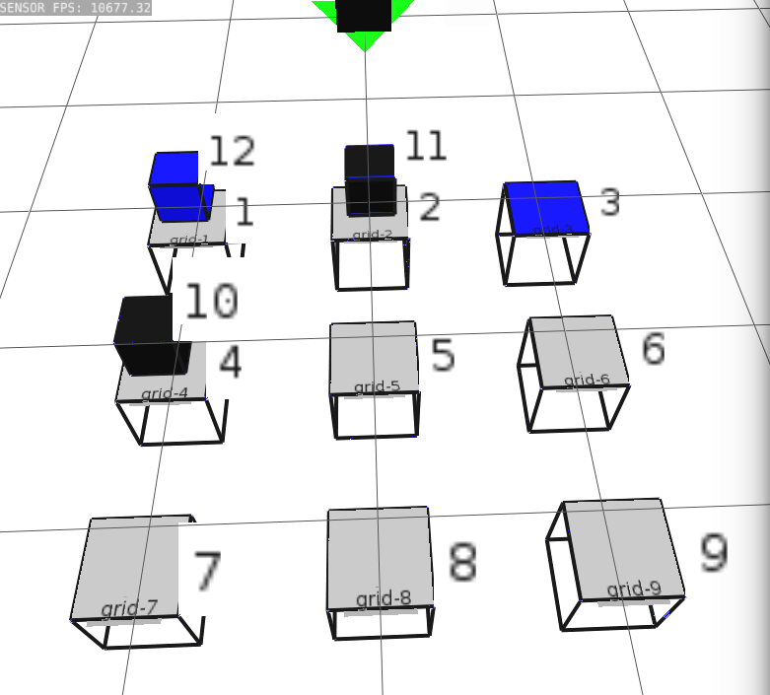
Easy interaction failures
Easy | Medium | Difficult
Single attribute Binary relation | Unsatisfied condition & Learned predicate or property of object required | Unsatisfied condition & Learned predicate or property of object required Inherent ambiguity
Mentor: A blue block is on a blue location.
Rosie: I do not see that. A blue block is not on a blue location.
Notes:
For example, here the blue block is NOT on the blue location, and it is expected to be.
Clearly we see that this is not rosie’s fault, there is clearly no blue block on a blue location, but that’s the whole point, we want the user to identify whether rosie understands exactly that. All these examples that I am going to highlight where the user’s insturciton is wrong, because it is easiest to lay out, however the failures in the study do include other mismatches in knowledge.

Slide 26
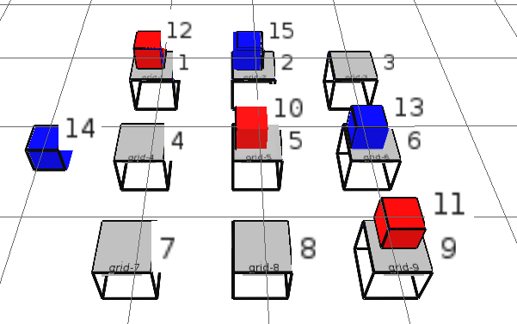
Medium interaction failures
Easy | Medium | Difficult
Single attribute Binary relation | Unsatisfied condition & Learned predicate or property of object required | Unsatisfied condition & Learned predicate or property of object required Inherent ambiguity
Mentor: You can move a free red block onto a clear location.
Rosie: I cannot do this action. I do not see a free red block.
If a block is not on a location, then it is free.
Notes:
if a block is not on a location then it is free.

Slide 27
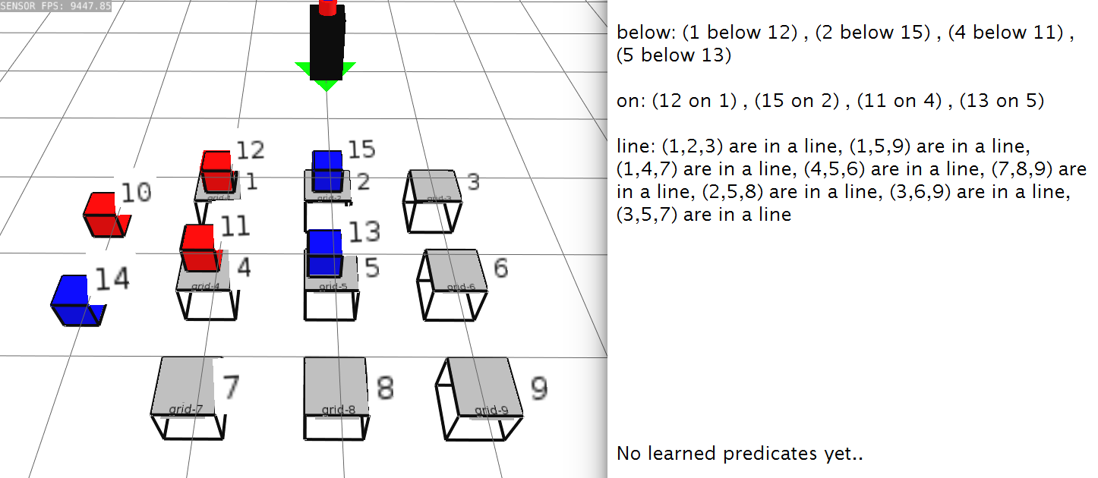
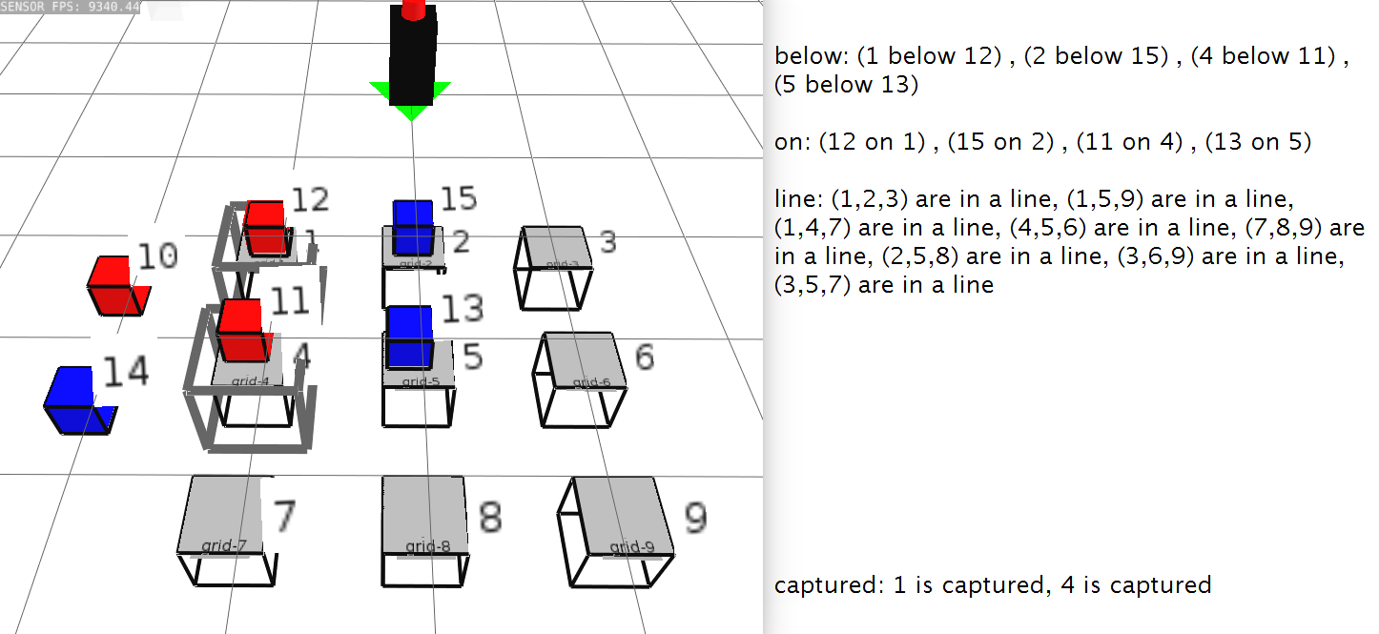
Difficult interaction failures
Easy | Medium | Difficult
Single attribute Binary relation | Unsatisfied condition & Learned predicate or property of object required | Unsatisfied condition & Learned predicate or property of object required Inherent ambiguity
Mentor: Three locations in a line are captured.
Rosie: I do not see that. The locations in a line are not captured.
If an object is below a red block, then it is captured
Notes:
There are two things that could have led to this failure
Rosie may not have the same meaning of what captured means
If they do have the same meaning,
What color blocks are they referring to? Line generated by blue or by red.

Slide 28
Outline
Transparency mechanisms
Taxonomy of interaction failures
User study
Results
Discussion
Notes:
How do our implemented transparency mechanisms help the user identify the reason for these failures.

Slide 29
Study design
 |  | Transparency mechanisms
Kinds of failure |  | None | Q-A | Screen | Both
 | Easy
 | Medium
 | Difficult
Dependent variables: accuracy, text-answer accuracy, confidence, time
Interaction failures across 5 games and puzzles
Conducted study on Mechanical turk (N=64)
Randomized
order of examples
transparency mechanisms available with example
Notes:
Tower of hanoi,tictactoe,blocks-world,five-puzzle,simple-maze
Users get access to all four transparency conditions
All participants saw all conditions.

Slide 30
Evaluating user’s mental model of robot
Reason for failure: Cues provided by robot influence user’s mental model [Kiesler, S., ROMAN ‘05]
Accuracy and confidence: Measure user’s prediction of robot’s behavior [Norman, D., Mental models ‘14]
Response time
Notes:
Three things to evaluate
Reason for failure -> I used transparency mechanisms as cues
Accuracy and confidence ->I looked at person’s prediction of robot behavior
And response time
Even though multiple works implicitly study mental models based on the robot’s performance and the human’s success, very few explicitly evaluate said mental model. Based on my research, in terms of hri, only perlmutter et al have explicitly looked into mental model evaluation, although it was in terms of simple commands given by the user.
Don Norman states that it is hard to ask people to describe the mental model. We can take a shot at it, by asking them to predict the robot’s behavior. Hence our tasks involves measuring accuracy and

Slide 31
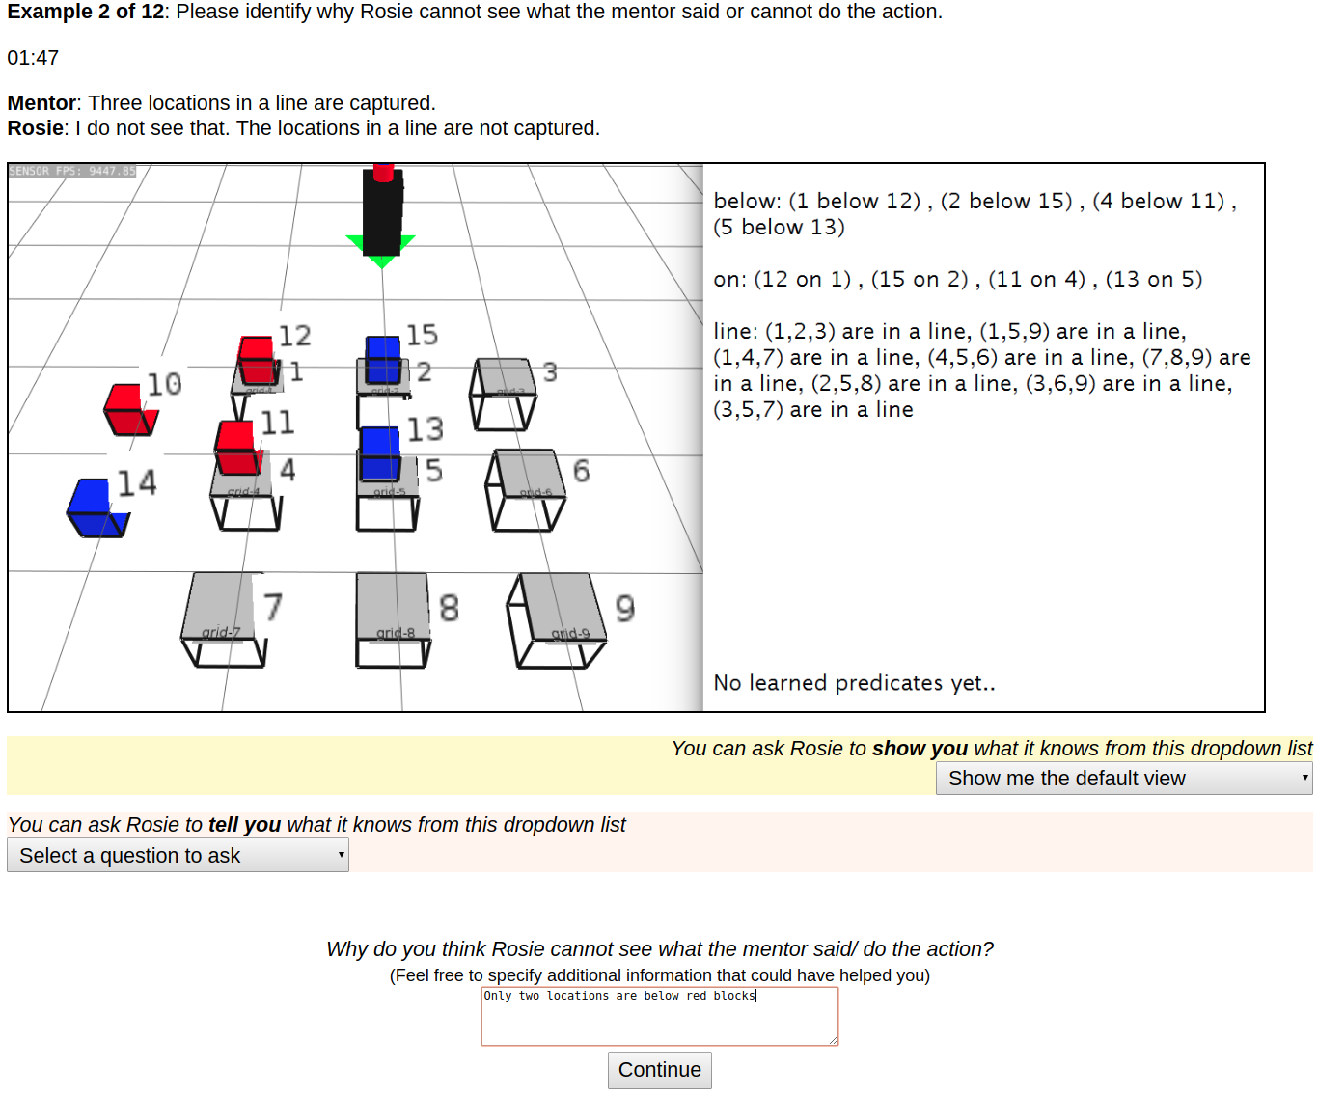
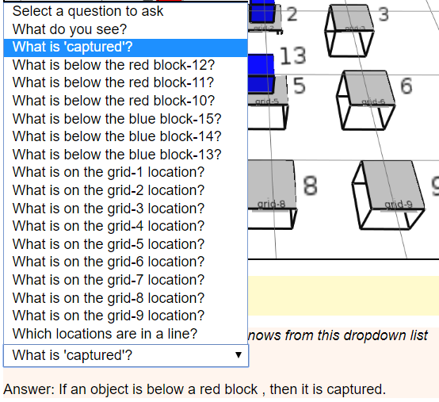
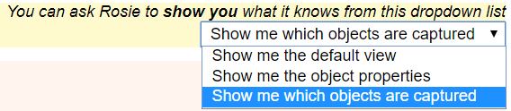
User study - Example
Notes:
Thus we designed a task where we present multiple kinds of interaction failure to the non-expert user, provide them implemented transparency mechanisms to access the robot’s knowledge and test whether they can identify the reason for the interaction failure
This is an example of what the study participant would see.
This is a situation where both q-a and screen mechanisms are avaiable.
This is a typical user interface presented to the user. They will be provided with a mentor-rosie conversation. I would like to note that the mentor is different from the user. In this case, the mentor specifies that three locations in a line are captured. Rosie answers that it cannot see the same.
This is the environment that the mentor and Rosie are referring to. The number indicate the internal ids assigned by Rosie to the objets in its environment. Now, since this is an example where the user has access to both transparency mechanisms, they can use either or both to figure what led to Rosie’s failure n this stuation.
When they click the question-dropdown

Slide 32

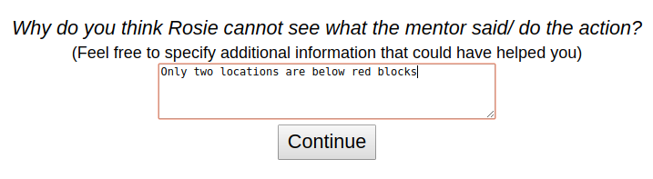
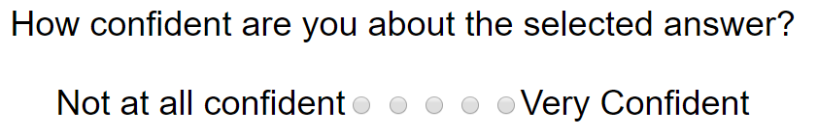
User study - Example
There are only two locations that are below red blocks.
There are three captured locations but they are not linear.
There are only two locations that are below blue blocks.
None of the above
I need more information.
Notes:
Cues provided by robot -> effect on human understanding
Prediction of robot behavior -> measure using accuracy and confidence

Slide 33
Research questions
How can transparency mechanisms help a user identify the reason for an interaction failure?
How do transparency mechanisms expose different kinds of failure to the user?
Notes:
How much information (via transparency mechanisms) is required to fill the gap of mental model?

Slide 34

Hypothesis 1
Transparency mechanisms will …
Easy interaction failures
Medium and difficult interaction failures
Notes:
Have an effect of “identifying the reason”

Slide 35
Hypothesis 2
As we move from easy to difficult interaction failures….
Accuracy
Confidence
Time
Notes:
The second hypothesis attempts to validate our taxonomy of failures. We want to understand how different kinds of failures affect a user’s prediction of the robot’s failure.

Slide 36
Outline
Transparency mechanisms
Taxonomy of interaction failures
User study
Results
Discussion
Notes:
How do our implemented transparency mechanisms help the user identify the reason for these failures.

Slide 37
Accuracy – Effect of transparency mechanisms
Level | Expected | Actual
Easy
Medium
Difficult
Notes:
Level ->

Slide 38
Accuracy – Transparency mechanisms at easy level
 | Accuracy (Mean)
Expected | Q,S,B,N – No significant variance
Actual | Q,S,B,N – No significant variance
None (N) | 81.5%
Q-A (Q) | 78.8%
Screen (S) | 75.9%
Both (B) | 73.7%
Notes:
Pairwise-tests

Slide 39
Accuracy – Transparency mechanisms at difficult level
 | Accuracy (Mean)
Expected | Q, S, B > N | None(N)
Q-A (Q) | 56.1% | 24.6% | ** p = 0.002
Screen (S) | 39.2%
 |  |  | p = 0.17
 |  |  | ***p < 0.001
Both (B) | 61.8%

Slide 40
Confidence – Effect of transparency mechanisms
Level | Expected | Actual
Easy
Medium
Difficult
Notes:
Level ->

Slide 41
Hypothesis 2 : Effect of difficulty level
As we move from easy to difficult interaction failures….
Accuracy Confidence Time
Notes:
Need to add significanc

Slide 42
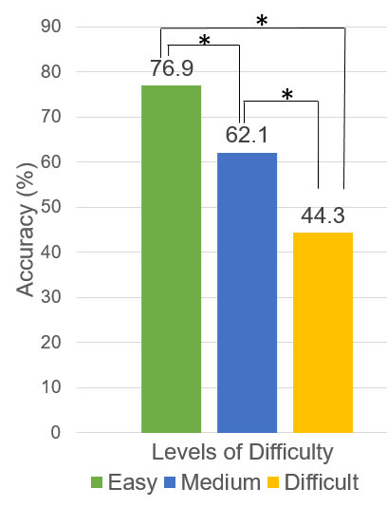
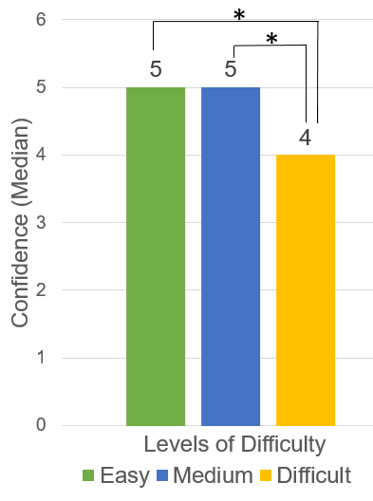
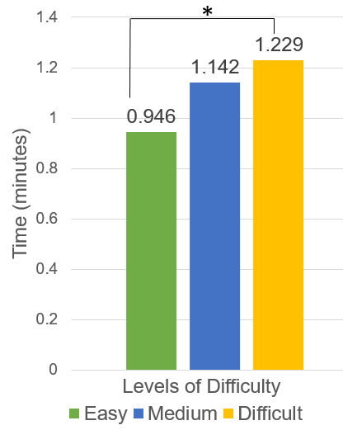
Hypothesis 2 : Effect of difficulty level
As we move from easy to difficult interaction failures….
Accuracy Confidence Time
Notes:
Need to add significanc

Slide 43
Text answers in difficult condition
Mentor: Three locations in a line are captured.
None: “Because red block 10 and blue block 14 are not on a block.”
Both: “Captured only occurs when a red block is on top of a location.There are only 2 blocks captured, thus there cannot be a line.”
Notes:
High correlation between text answer and actual answer.-> moderate to strongly positive
R² ranging from 0.085 to 0.671

Slide 44
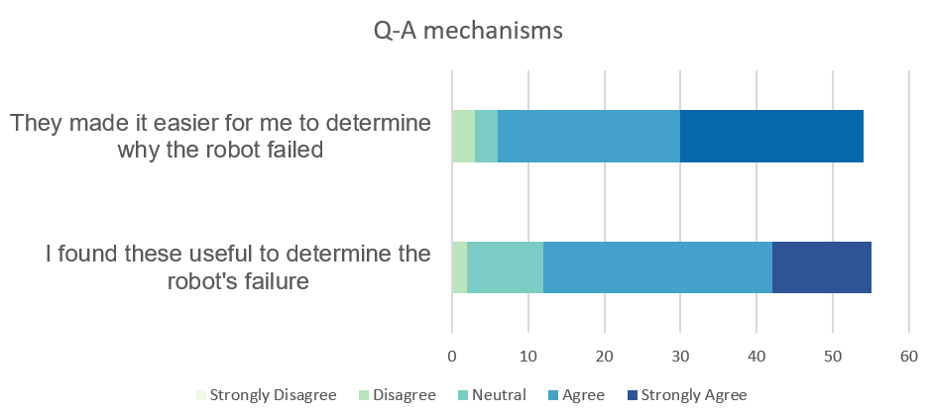
User responses: Q-A mechanisms
P14: “I liked it, because it helped me answer the question being asked in a more specific way.”

Slide 45
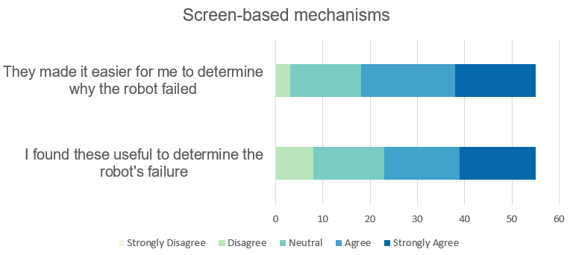
User responses: Screen-based mechanisms
P9: “This was helpful in letting us know what the computer actually saw in its point of view”

Slide 46
User review - Preference
P4 - Both: “Both were very helpful to get a definition and then see it visually. Putting the two sources together made a more certain opinion in my mind about the correct answer”
P2 –None: “I felt like they were good. I didn't always use them though if I felt they weren't needed.
Notes:
2 did not provide any response
1,20,13,19
Something positive
Spmethng negative

Slide 47

Conclusions
Implemented 2 types of transparency mechanisms
Q-A mechanisms
Screen-based mechanisms
Identified taxonomy of interaction failures
As Difficulty , Accuracy
Effect of Transparency mechanisms -> Difficult Failures
User prefers
Q-A & Both > Screen
Notes:
Identified -> that was empirically validated

Slide 48
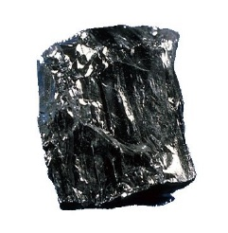

Nuggets and Coal
Didn’t see significant effect of screen-based mechanisms
Could not confirm hypothesis w.r.t “medium” failures
Difference in types of failures relevant
This study provided baseline data for user understanding
Beginning to understand human mental model
Notes:
better in dynamic environments, not in static potentially -> also can have too much information sometimes, so we need exploring
Not enough separation between levels
FIRST Study where we actually studied how users might interpret these type of failures and how they use these transparency mechanisms, at least with respect to Rosie

